Slide 1
Agriculture
Exchange project Slovenia and the Netherlands
Anže Štirn and Bart Penninx
sentvidudenagriculture.blogspot.com

Slide 2
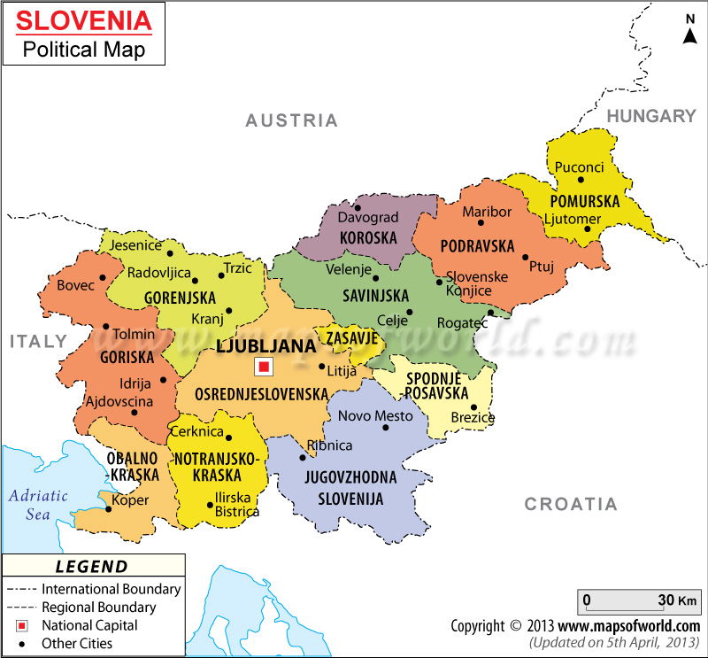
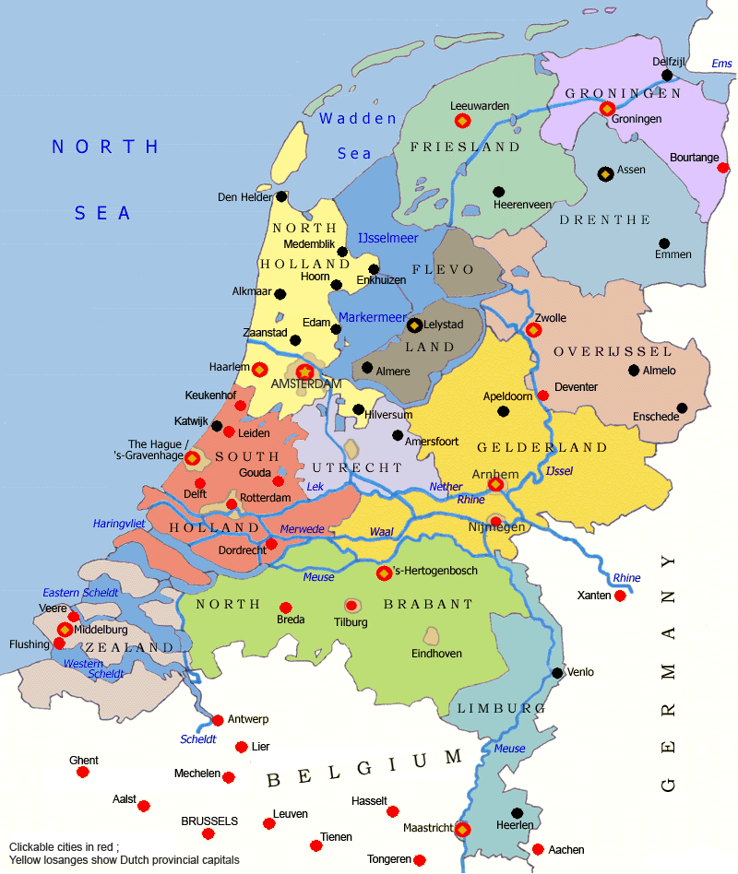
Main question :
What are the main differences in milk production between the Netherlands and Slovenia?
Slovenia
The Netherlands

Slide 3
Sub questions :
Which country has the highest efficiency (grass to milk)?
Which country produces the best milk quality?
Which options does a farmer have, to make his farm more efficient?
Is the amount of cows on one farm different between the two countries, and how does that influence the quality?
What impact does the relief have on the efficiency of farming in the Netherlands and in Slovenia?

Slide 4
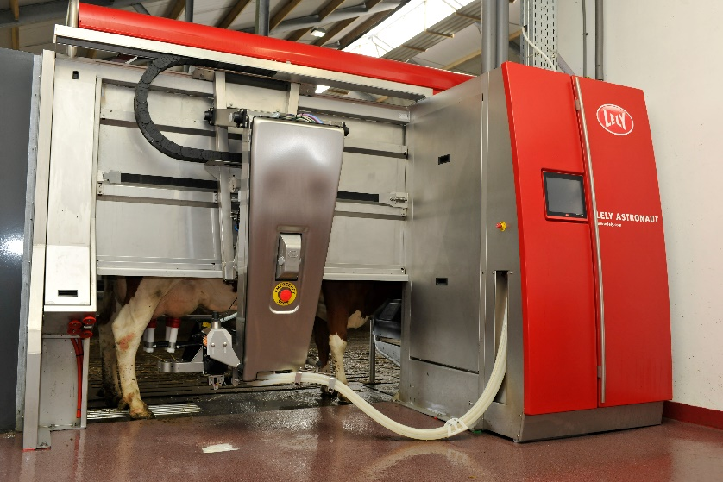
1. Which country has the highest efficiency (grass to milk)?
Tons of milk on a cow on a year
 | 2012
The Netherlands | 7,73
Slovenia | 5,63
Tons of milk per HA
 | 2012
The Netherlands | 12,75
Slovenia | 3,44
Relief
Milk and meat cows

Slide 5
2. Which country produces the best milk quality?
Protein%
 | 2012
The Netherlands | 3,53
Slovenia | 3,3
Optimal | As high as possible
Fat%
 | 2012
The Netherlands | 4,40
Slovenia | 3,6-4,2
Lactose%
 | 2012
The Netherlands | 4,54
Slovenia | 4,7
Fat% : Proteins% is normally around 5:4
Lactose is rewarded the most, then pproteins, then fat

Slide 6
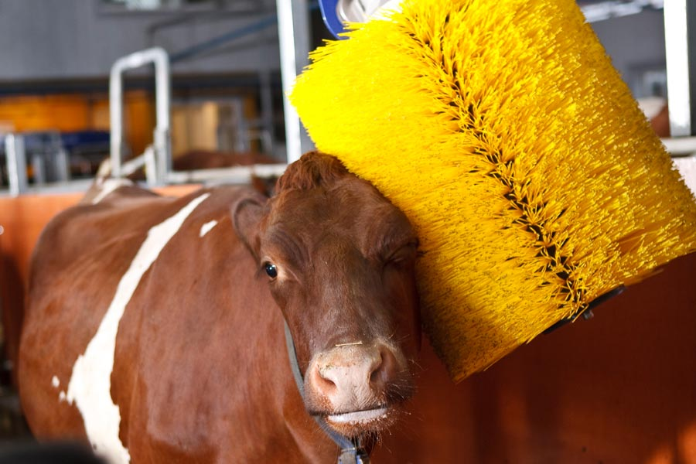
3. Which options does a farmer have, to make his farm more efficient?
Animal well being and efficiency
Small investments

Slide 7
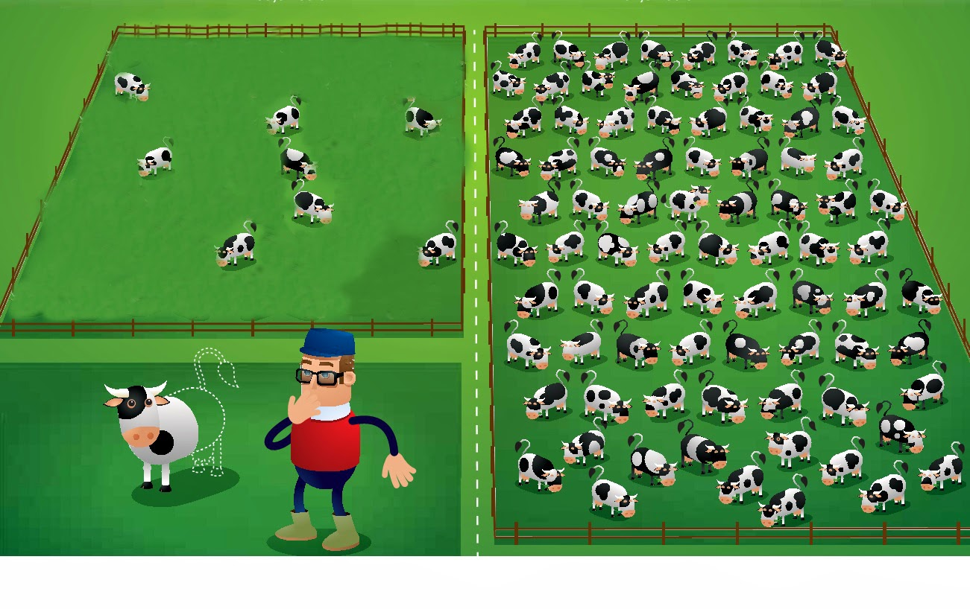
4. Is the amount of cows on one farm different between the two countries, and how does that influence the quality?
Average cows on farm
 | 2012
The Netherlands | 79,71
Slovenia | 3,85
Tons of milk
 | 2010
The Netherlands | 11468581
Slovenia | 625.000
Dairy cows
 | 2012
The Netherlands | 1484000
Slovenia | 111022
Relief has a great influence on the maximum capacity of a farm.
Lands of Slovenian farmers are most times scattered in a range of 10 km.

Slide 8
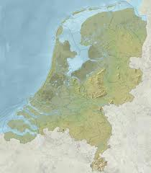
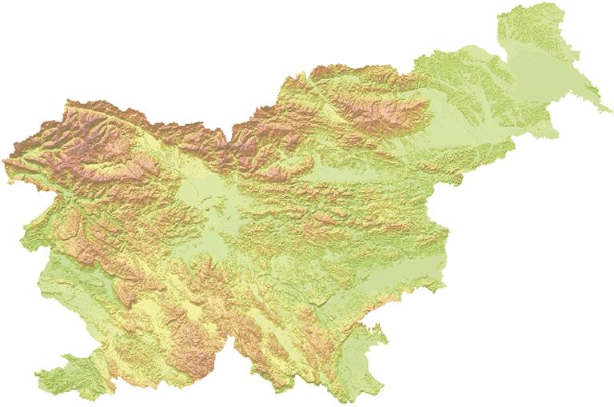
5. What is the impact of the relief on the efficiency of production in the Netherlands and in Slovenia?
Nr. Dairy farms
 | 2010
The Netherlands | 18.618
Slovenia | 28.824
Other equipment
Triglav 2864 m
Vaalserberg 323 m

Slide 9
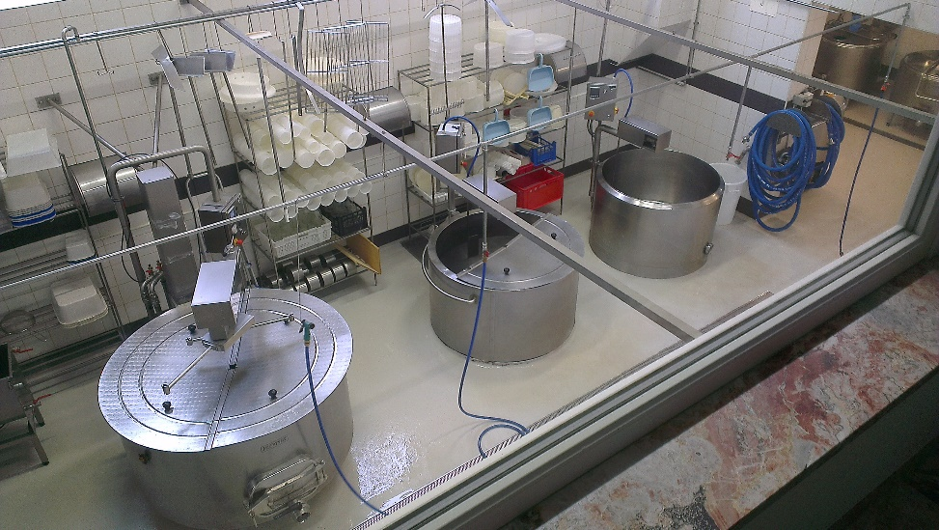
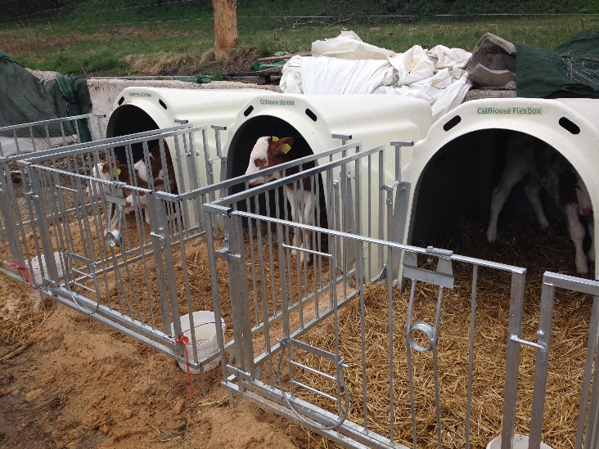
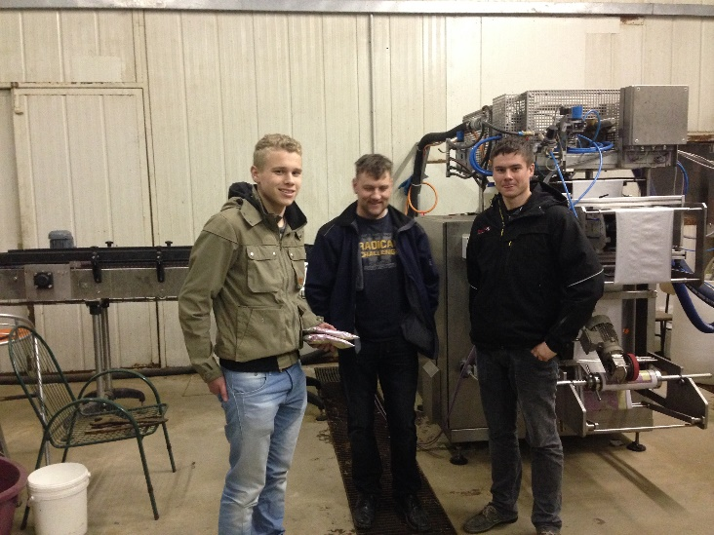
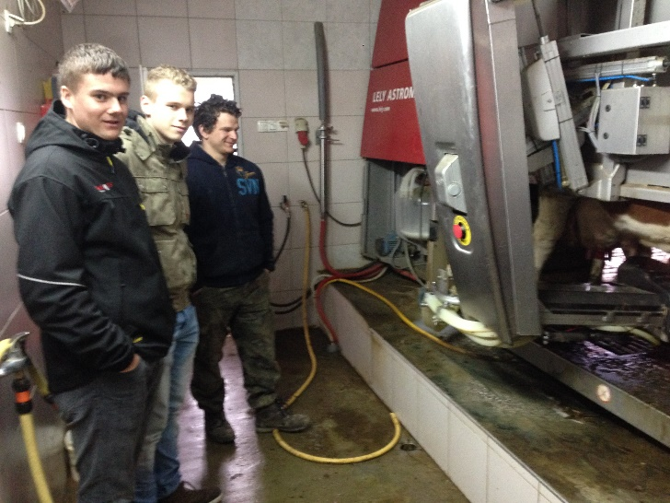
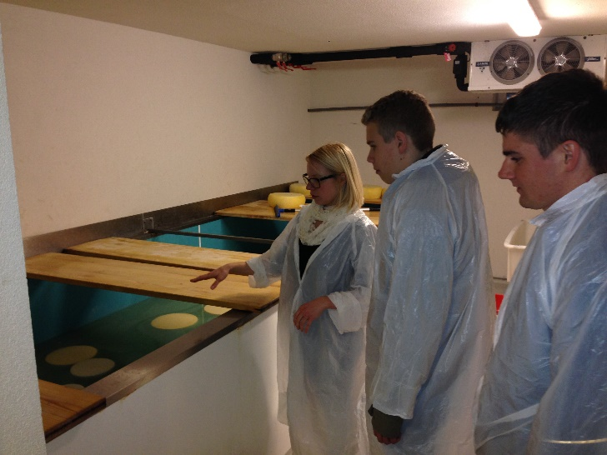
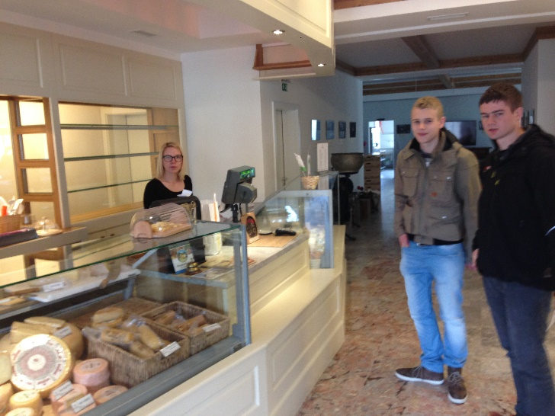
Excursion

Slide 10
Conclusion
Milk production is more efficient in the Netherlands
Quality of the milk is about the same
The relief has a great influence on how a farmer produces milk, and his maximum capacity
The relief in Slovenia makes it harder to cultivate crops, and other specially adapted equipment has to be used.

