Slide 1
FORESTS IN SLOVENIA AND NETHERLANDS
Project by: Ana Lovrenčič and Juliette van Acker
http://anajulietteexchange.wordpress.com/

Slide 2
WHY DID WE CHOOSE THIS SUBJECT?
Slovenia: many forests energy
Netherlands: less forests, recreation

Slide 3
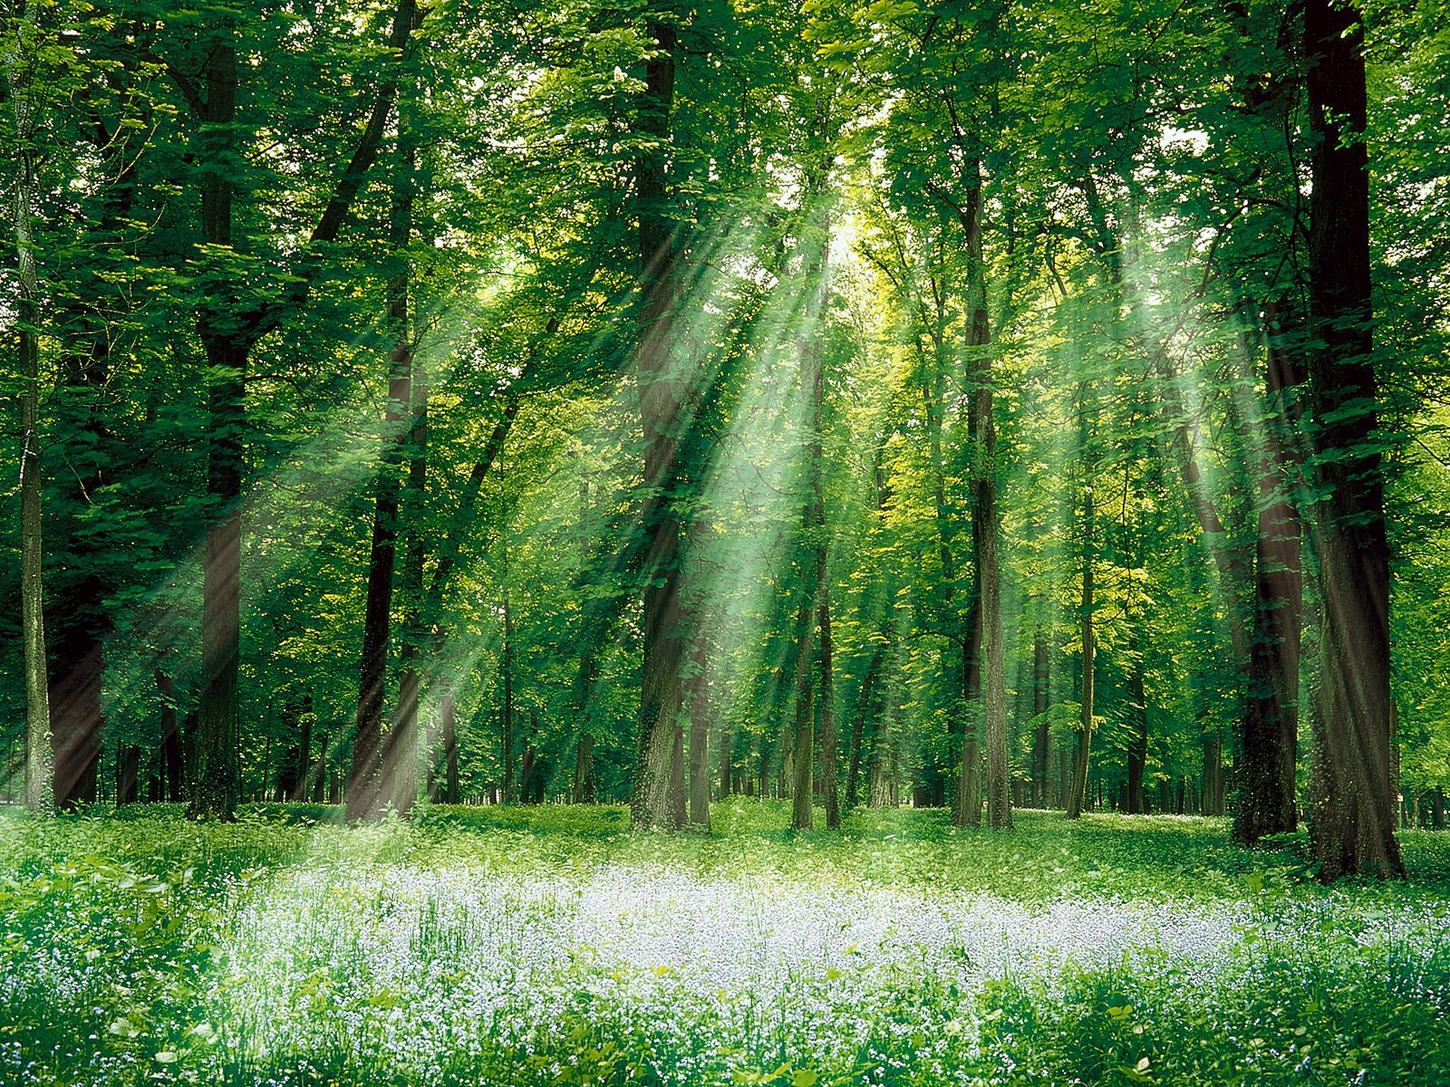
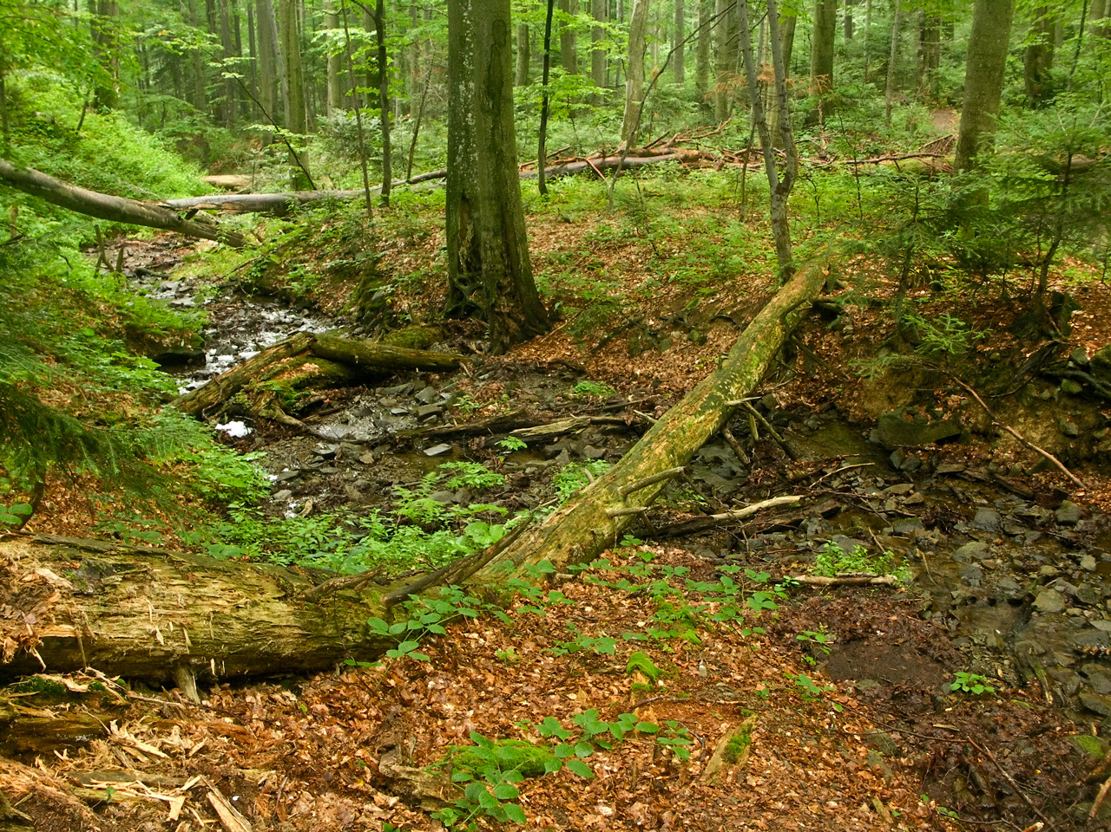
FOREST
What‘s is exactly meant by a forest?
It‘s a highly complex, constantly changing environment made up of a variety of living things

Slide 4
SLOVENIA | NETHERLANDS
third most forested country | the least forested
44 protected areas | 21 protected areas
Triglav National Park - 83.807 ha | The Oosterschelde - 37.000 ha
5.200 animal species | 569 animal species
950 species of plants | 1221 species

Slide 5
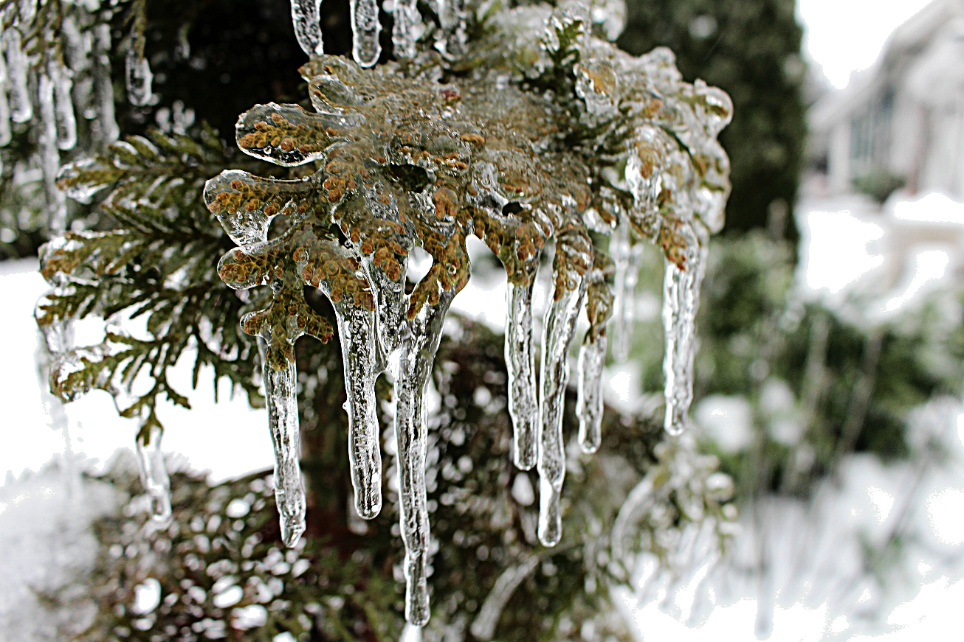
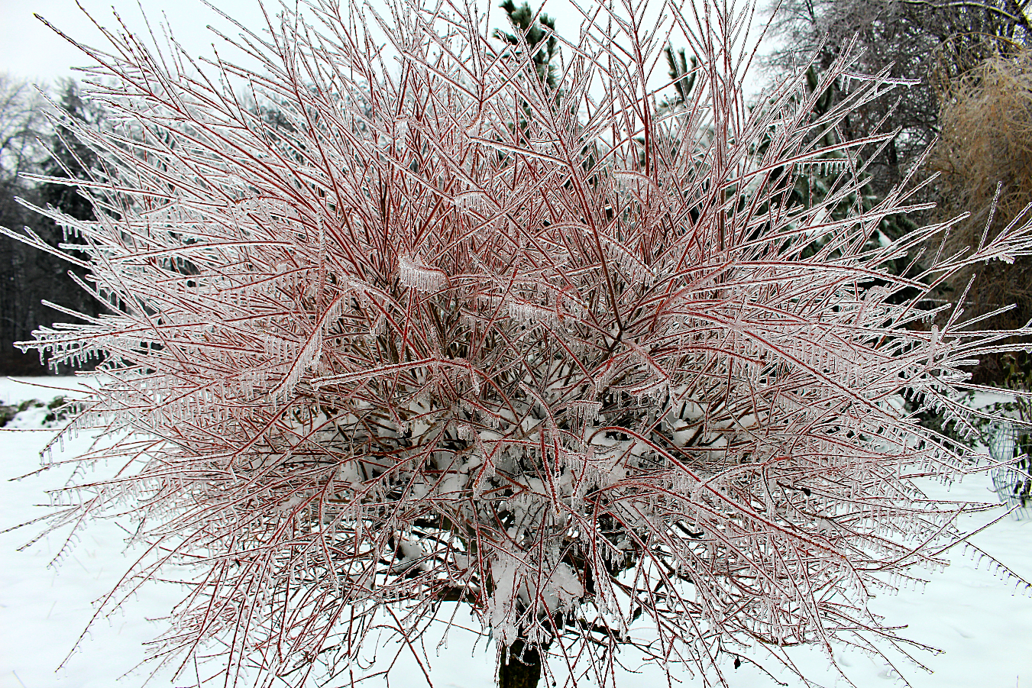
GLAZE ICE
smooth, transparent ice coating
430 million euros

Slide 6
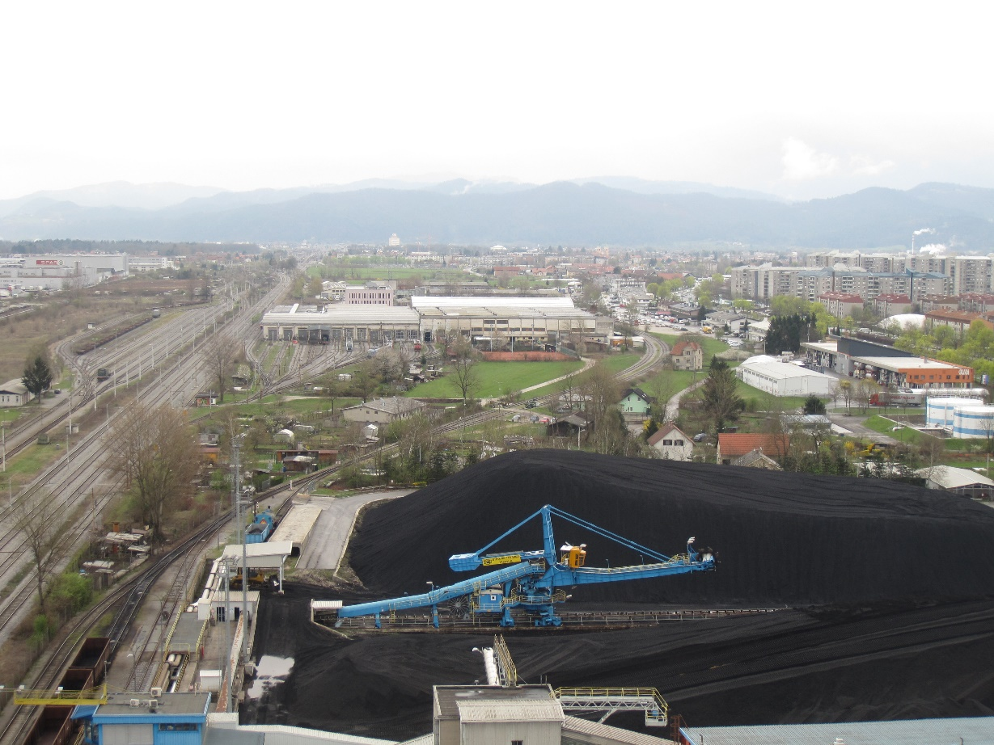
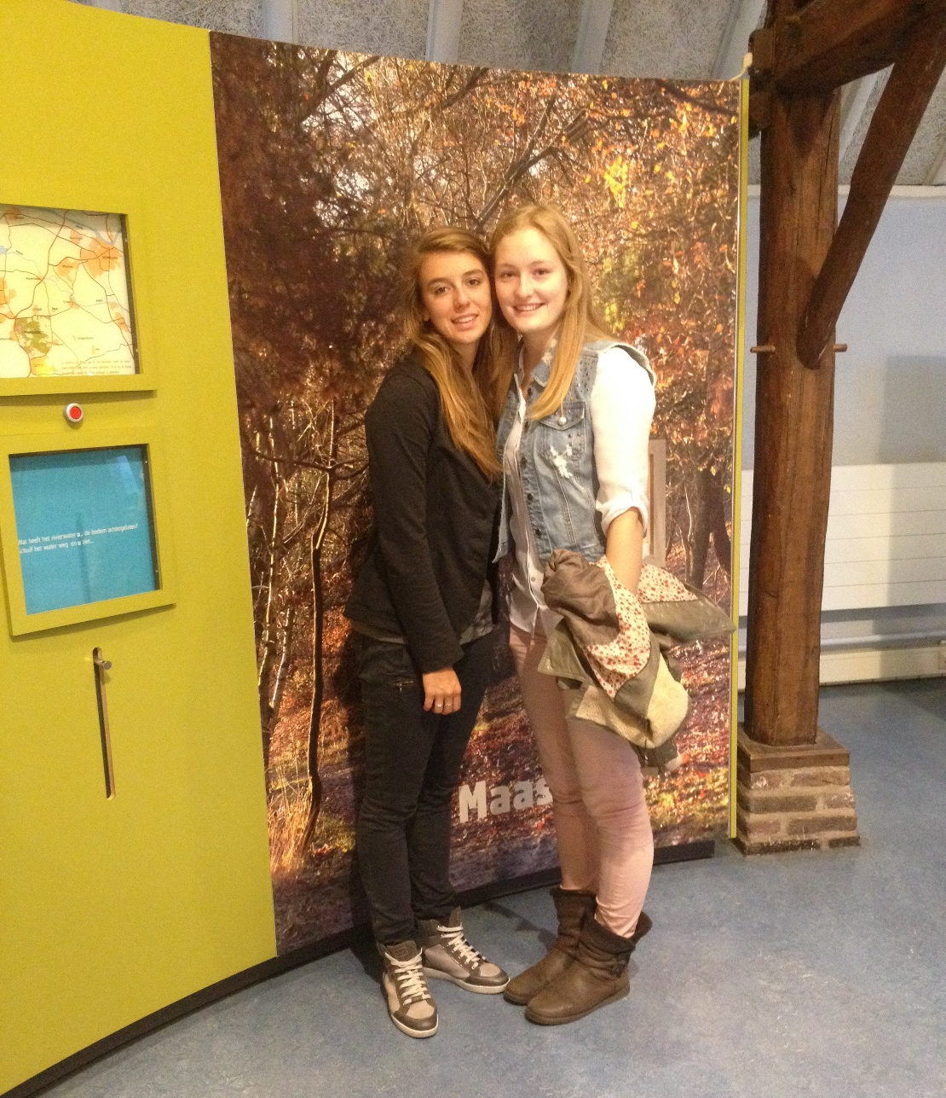
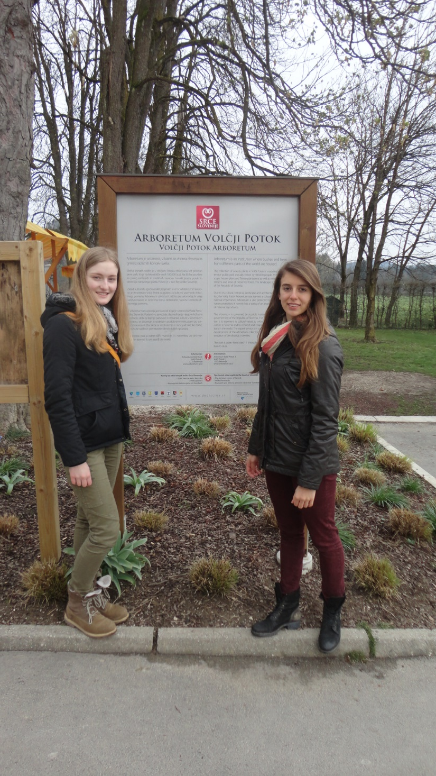
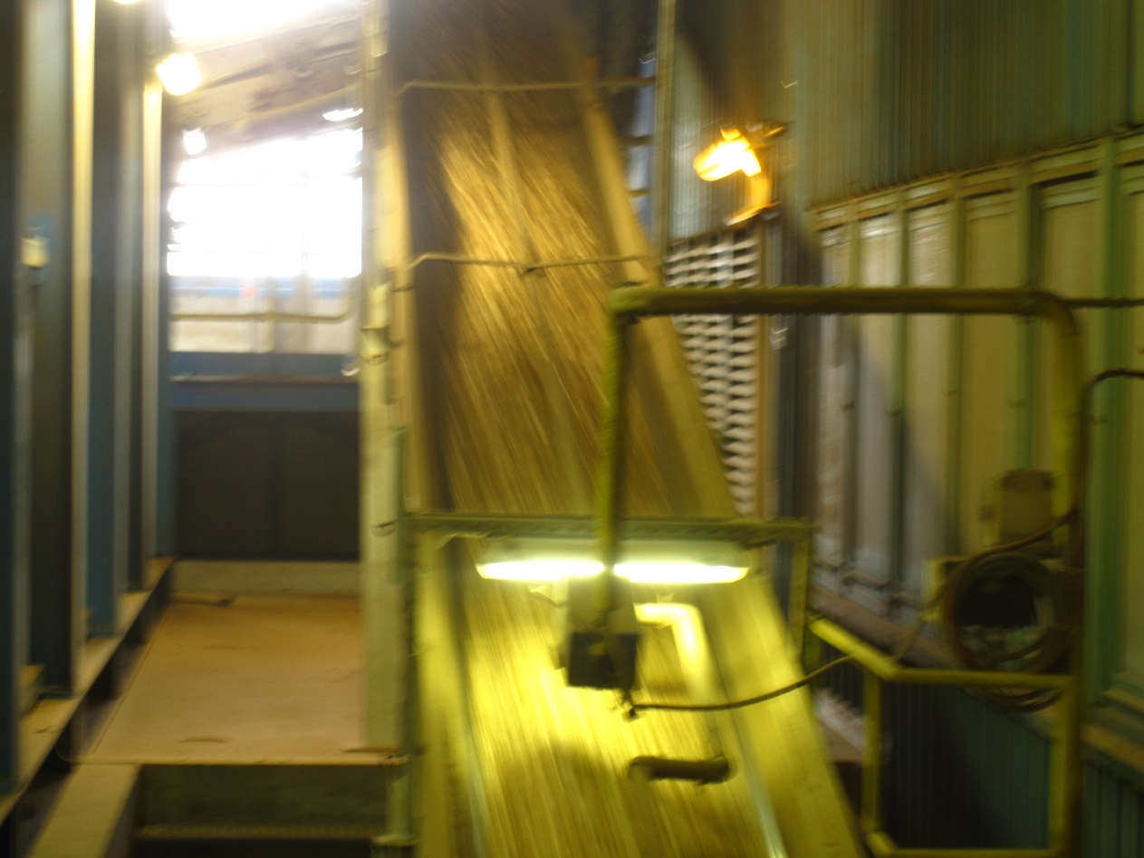
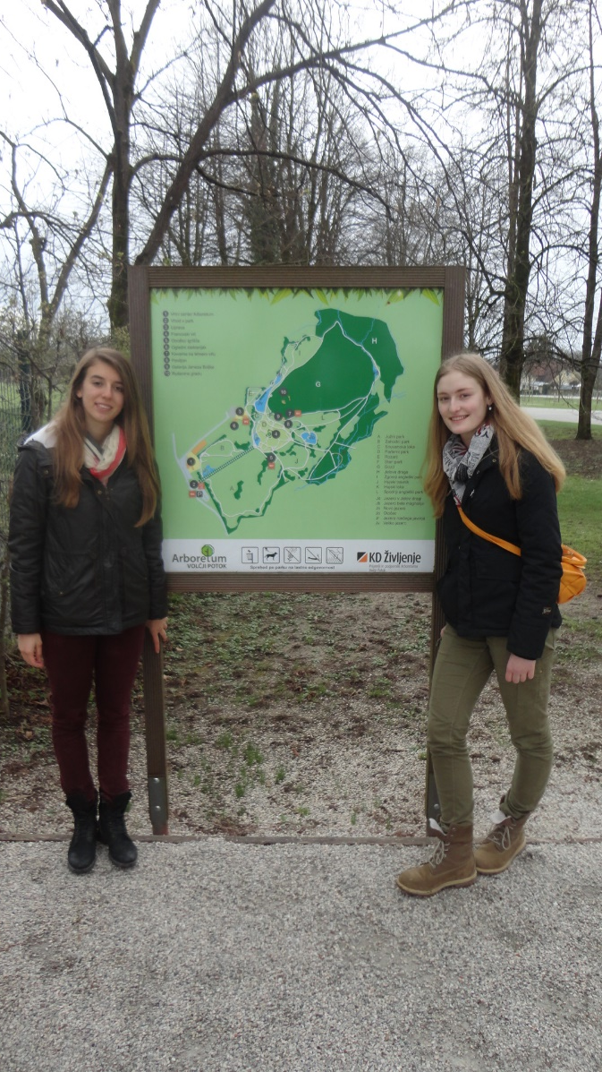
EXCURSIONS
- DE MAASHORST
- TE-TOL
- ARBORETUM

Slide 7
CONCLUSION
Extreme weather by pollution endangers the forests
Slovenia: 50% of the trees was damaged during the February glade
The Netherlands: trees on Terschelling were banned
Solution: reduce global warming
Reduce use of cars, put the cargo on the train and use renewable energy

Slide 8
THANK YOU FOR YOUR ATTENTION !

