Slide 1
SPORTS BY GREGOR AND GUUS
Exchange project 2013/2014
http://sportsdoubleg.blogspot.com/

Slide 2
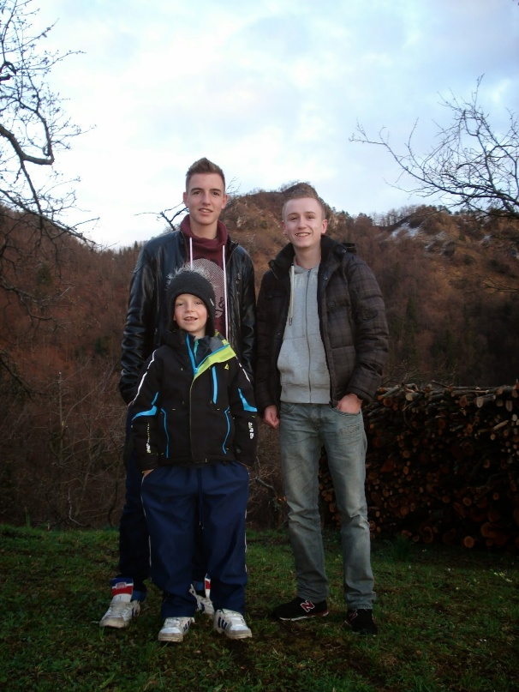
Guus and Gregor
We choose that topic becouse we both like sports and we already know a lot about it. We enjoyed working together. We had a great time.
Our main question is what are the differences and similarities between the two/three most popular sports in Slovenia and the Netherlands?

Slide 3
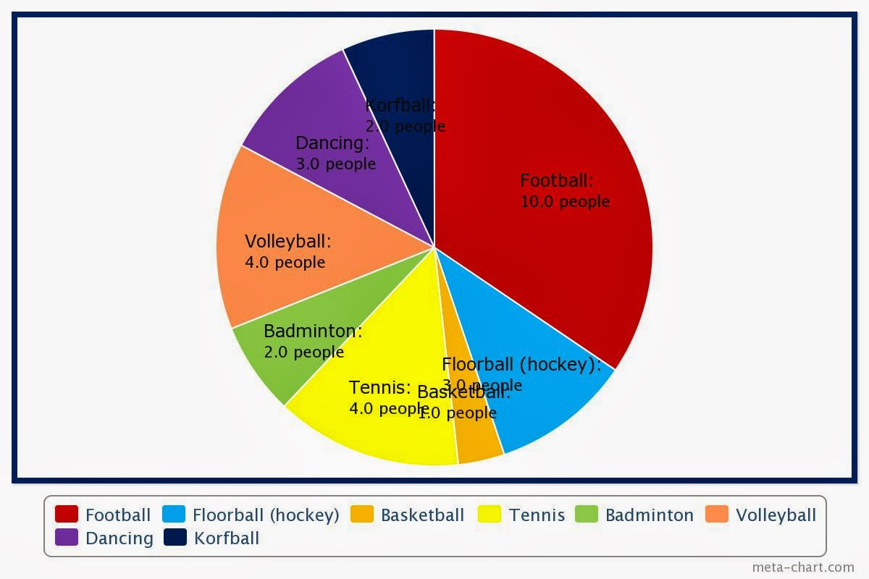
Sub-questions
1. Which sports we chose and what are the criteria for our choice?
As the most popular sports in Holland we took football and athletics. Football is not hard to explain. Everyone in Holland knows about football, even if you don't want to. A lot of younger children are practising the sport. Also our survey showed that a lot of people think this is the most popular sport. For athletics we have other criteria. In Uden there is a very big athletics stadiums, one of the first so called 'Mondo' tracks in Holland. Many people think of athletics when they hear the word sports.

Slide 4
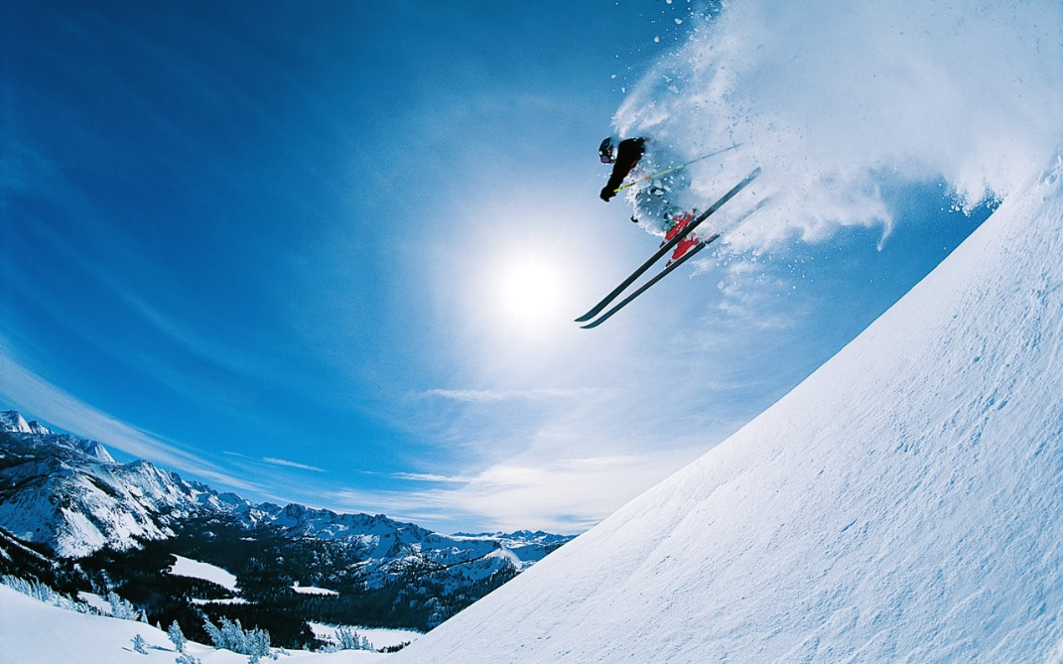
Sub-questions
As the most popular sports in Slovenia we took skiing and football. Slovenia has a lot of mountains, so Slovenians got the possibility to practise skiing. Many of the famous sportsman born in Slovenia pratice skiing. We visitied the skiing course and we saw that the club pays a lot of attention to the course. Also almost everyone of the youth likes football. They ofthen go out to the playground and play some games of football with friends.

Slide 5
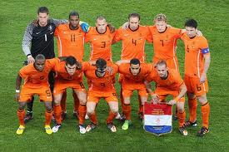
Sub-question
2. How good do the countries participate in the championships of these sports?
Holland is a good participant in the world of football. A lot of famous player are born and started playing in Holland (for example Robben). We've also won the world championship some times. We're also not doing bad in the athletics championships. The players are not that famous, but the Dutch are doing well in the competition with others.

Slide 6
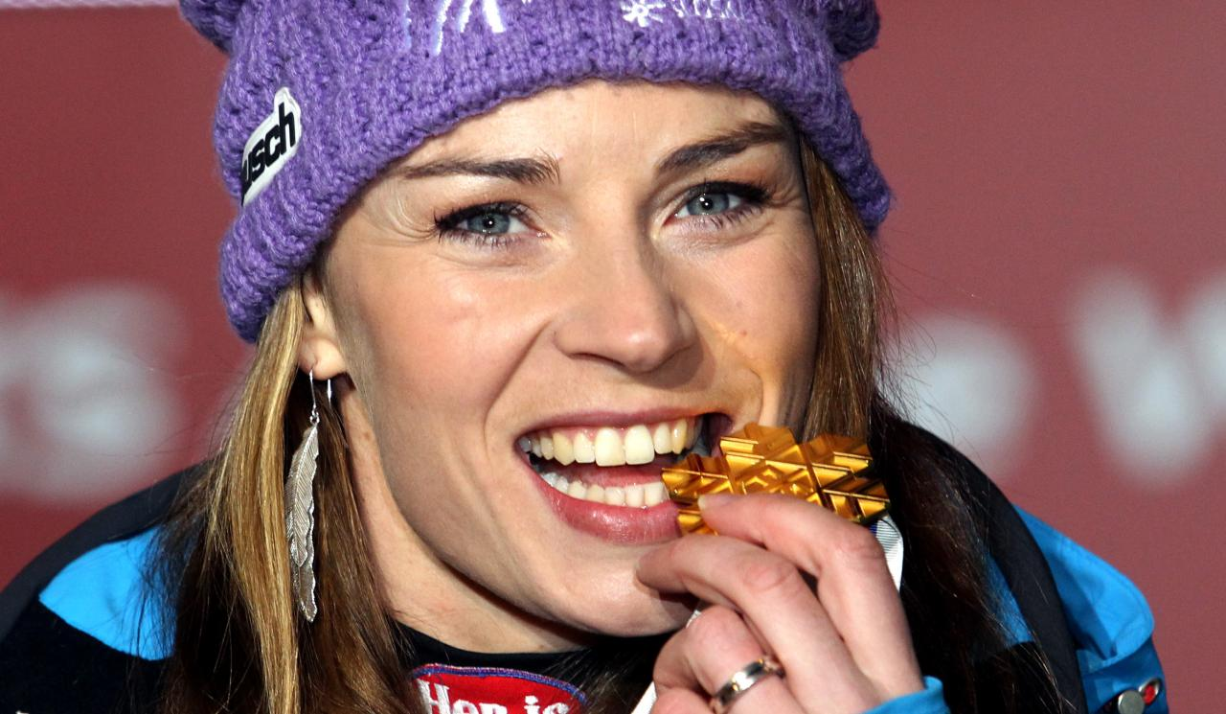
Sub-question
Slovenia is doing really good in skiing, especially at womens skiing. Slovenia has won a lot of awards, also on the Winter Olympics. Our best skier is Tina Maze. She accomplished a lot of things in her life. Slovenia is not that good in football. But they enjoy practising it and that's why someone practises sport.

Slide 7
Sub-question
3. How much training time need these sports?
Of course the sports need a lot of practice. We tried to look at the differences but we found out its a bit of the same. Sportsmans approximately train 2-4 times a week. There's also a difference between the training. A skiing course can last for 3 hours easily. A football/athletics training lasts only for like 1,5 hours.

Slide 8
Sub-question
4. How accessible are the sport facilities?
The most of the time the sporting facilities are really accessible. In Uden and Ljubljana there are enough places where we could practice these sports. So we found out the accessibility is not a problem when someone wants to practise sports.

Slide 9
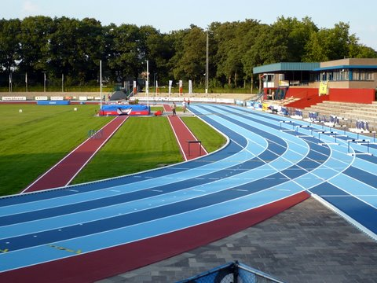
Excursions
In Holland we went to an athletics stadium. We interviewed a important person from the club and got some useful information. The club is called De Keien. They've got 650 members (100 youth members). Unfortunately most of the younger members stop practicing the sports when they grow older, they get other interest (puberty). Its not very expensive to pratice athletics.

Slide 10
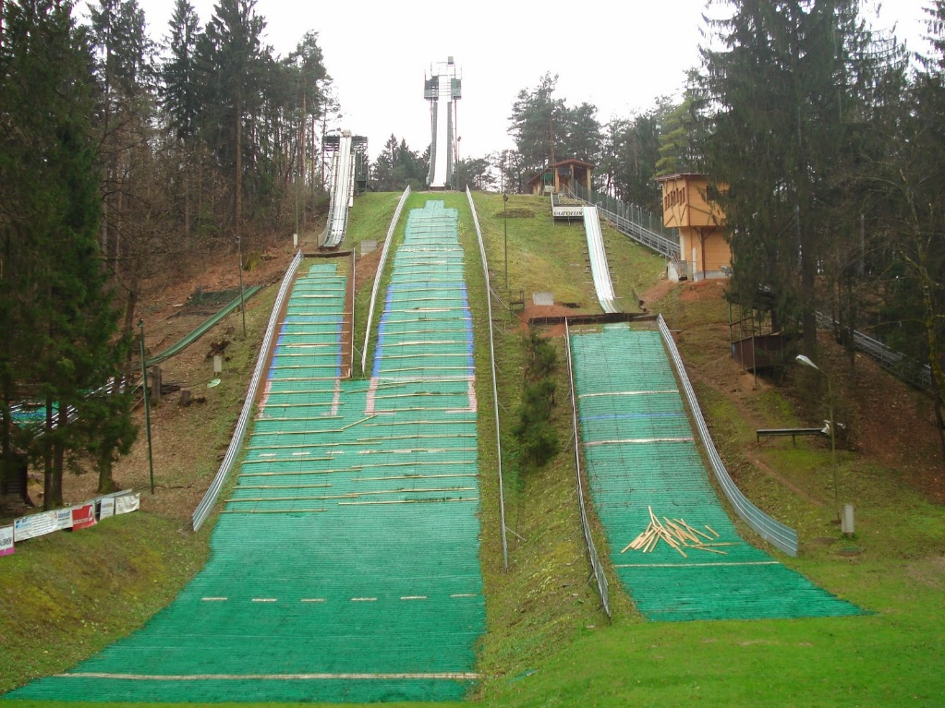
Excursions
On the excursion day in Slovenia we went to a ski jumping course. I (Gregor) told Guus my cousin is a professional ski jumper. Guus was really surprised. He told me he never went to a ski jumping course before and only saw the sport on the TV. We can confirm that Slovenia is a country with a lot of winter sports, sports with snow like skiing. In the Netherlands the sports praticed in the outside in the summer are a lot more popular.

Slide 11
Conclusion
Differences & similarities
Learning progress
Liked it
Hope others can use it
Thank you

