Slide 1
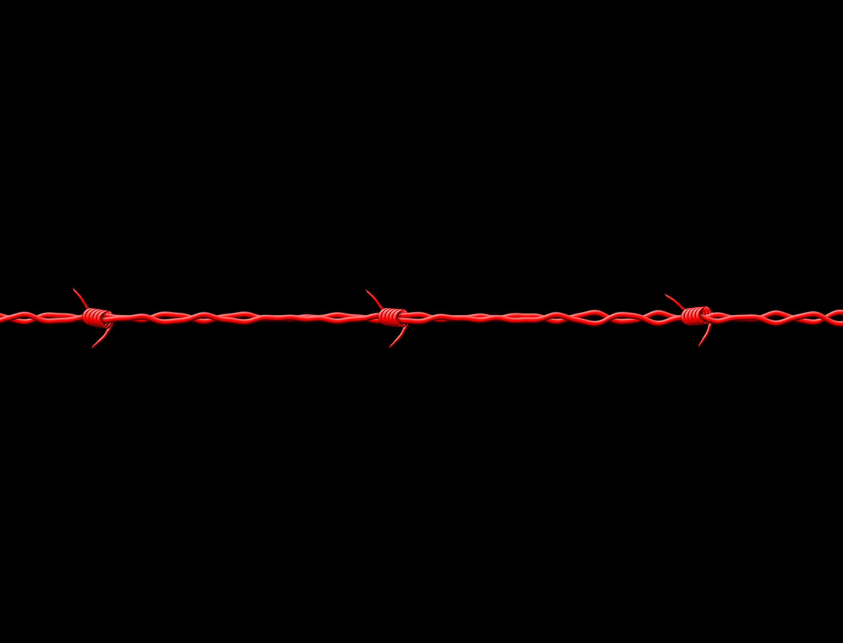
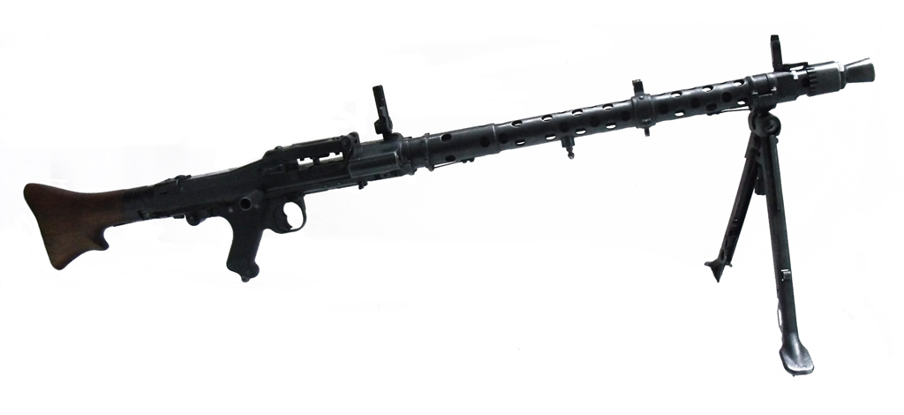
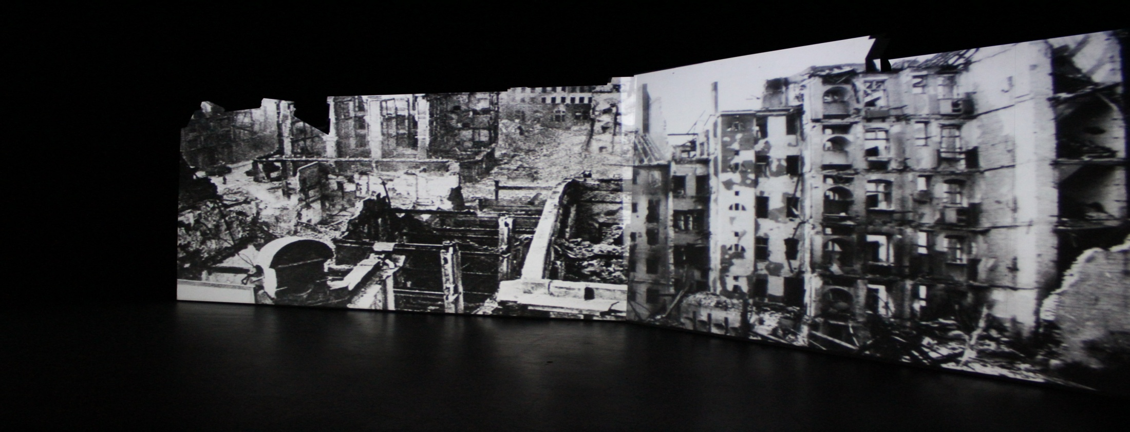
WORLD WAR 2
… how it affected people living in Slovenia and Holland?
with personal stories and old memories
hww2-project.blogspot.com/
Lana Fortuna & Robin Loesberg // 2013 - 2014 // exchange project

Slide 2
INVOLVMENT INTO THE WAR
SLOVENIA
THE NETHERLANDS
Triple pact signed on 6th April 1941
Germany bombarded Beograd
Slovenia was occupied by German and Hungary, Ljubljana region belonged to Italy
OF in 1945 defeated German army, Slovenia was liberated
Invaded on 10 May 1940
The fight lasted five days
Rotterdam was bombed on the fifth day and after that the Dutch surrendered.
1945 hunger winter
Liberated in September 1944, North half a year later

Slide 3
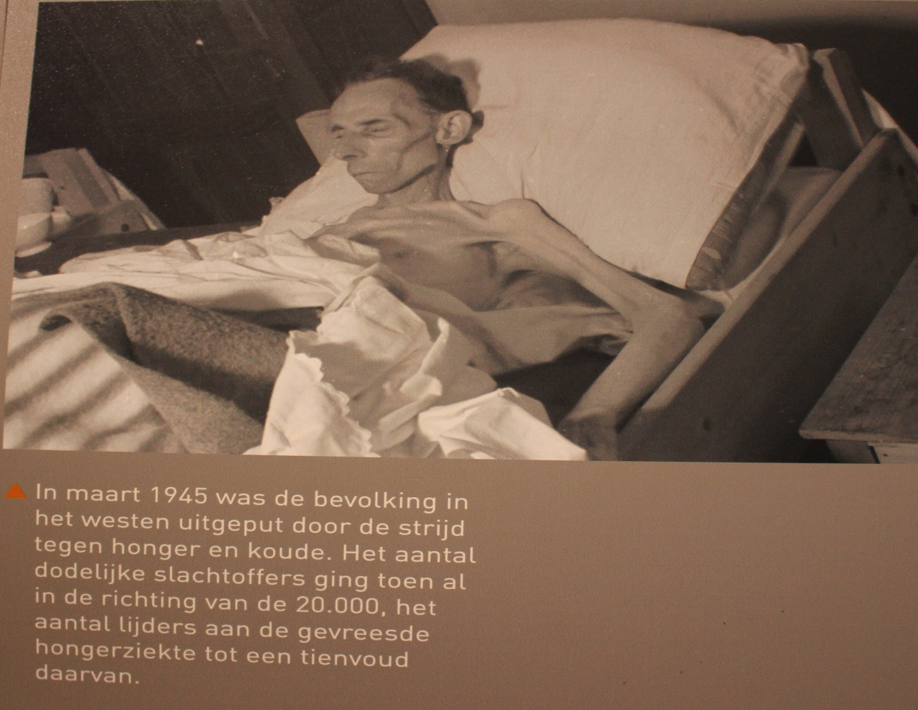
DURING AND AFTER THE WAR
Personal experiences, stories and memories.
Lack of food, supplies and no warm shelter
Fear of bombardments, army attacks and emotional trauma

Slide 5
INTERVIEWS
SLOVENIA
THE NETHERLANDS
Nikola Ladika with some help of his elder sister Lojza
Branko Mlačak
Johanna Cornelia Maria Bakker
.

Slide 6
Asked questions:
Introduce yourself (write something about your region in which you
have lived during the war and year of birth)
2. How old were you when the war started?
3. Did you know what was happening?
What kind of food did you have in that time, and did anything change
during the war?
How was the economy during the war? Did your family have enough
money?
6. Were you in school during the war, and if so, what changed?
7. Were you afraid, and were your parents afraid?
8. What was the most significant change that was caused by the war?
If you want to share some other memories with us, just write them
down
.

Slide 7
LIFE DURING THE WAR
SLOVENIA
„We lived in poverty, it was especially hard when drought came and there was not enough food for the family (parents, three children, two aunts and grandparents).“
„At the beginning of the war the children of course didn't realize the seriousness of the situation. We heard from our parents and relatives that the war is coming. When Italian soldiers rolled into our village with weapons, tanks and other military equipment, we realized that the worse possible scenario is becoming a reality.“
„I went to school regularly, except when enemy planes were flying over our village and bombed some parts of the area. In 1943 bomb hit our house and injured my mother and killed my 4 year old brother Miško, who was collecting fire wood near the house.“

Slide 8
LIFE DURING THE WAR
SLOVENIA
„We were living on a farm which made our lives a little bit easier. A bigger problem was sharing our food with soldiers who marched through our village.“
„They told us, children, how was the food like before the war but I just knew how the food was then and it was really good to satisfy hunger. Those who were born during the war, like me, thought that it had to be like this.“
„I was deeply shaken and scared when my mother was injured and my brother killed. That tragedy left deep scars in our hearts and those horrible feelings never left us. As war went on we became stronger and fear was also gradually driven away. In a way you become immune to tragic events and accept war as something ordinary.“

Slide 9
LIFE DURING THE WAR
THE NETHERLANDS
„Later I noticed some of it, because of our lack of food, I was hungry. “
„I know that at some point we had large pots of flowerbulbs on the table, and on the stove there were sugar beets simmering. In that time people ate everything they could get.“
„My father went to the North on a bike with wooden tires; there were many farmers. He traded his signet rings for the food, like wheat, beans, flour and fruit. When he did that we had enough to eat for a while.“
„There were droppings of food in cans, Swedish cookies. It's been in fashion for a long time to save those cans.“

Slide 10
LIFE DURING THE WAR
THE NETHERLANDS
„When I was five, I should've went to the kindergarten, but the Germans had taken over all the schools so I couldn't go.“
„My mother was terrified when there were „razzias „(German raids) or bombardments. If her husband was to be taken, she and her children would be left without an income.“
„When there were bombardments, we had to sit under the table with all the doors en windows closed and the lights out, so the plains wouldn't know where to throw the bombs.“
„When clothes got too small they just got pieces of fabric sown on.“

Slide 11
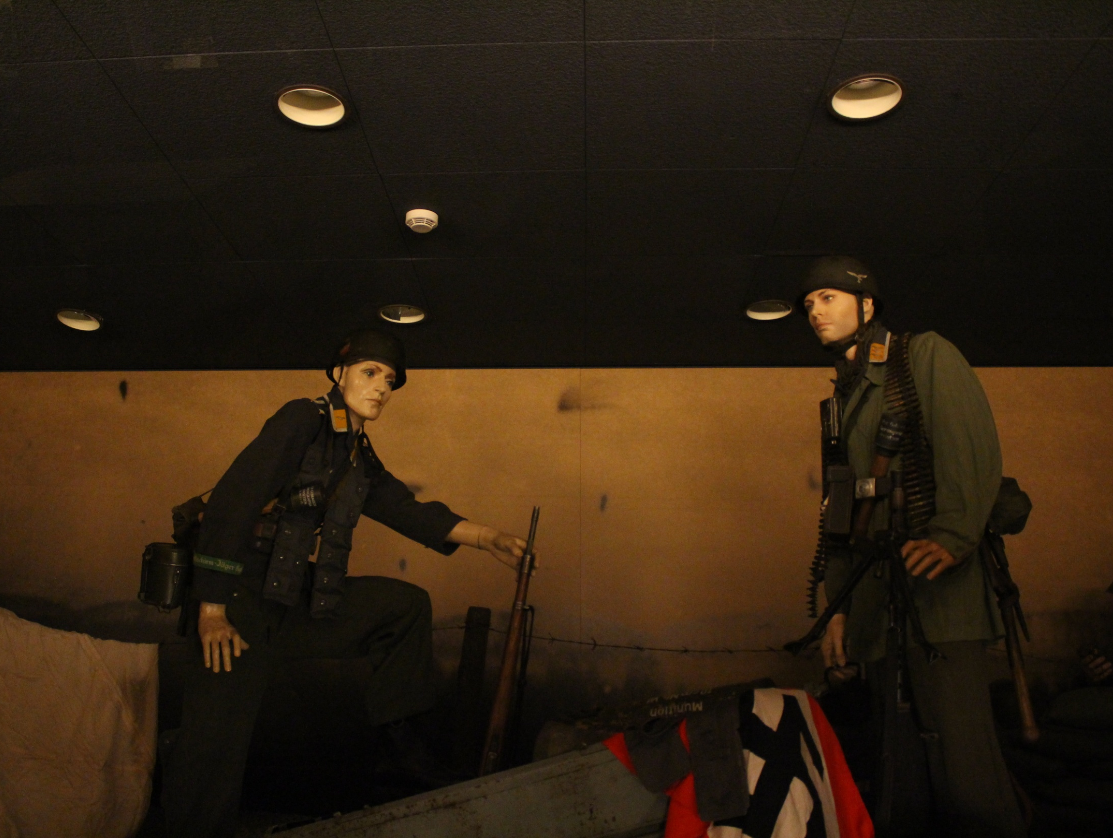

Slide 12
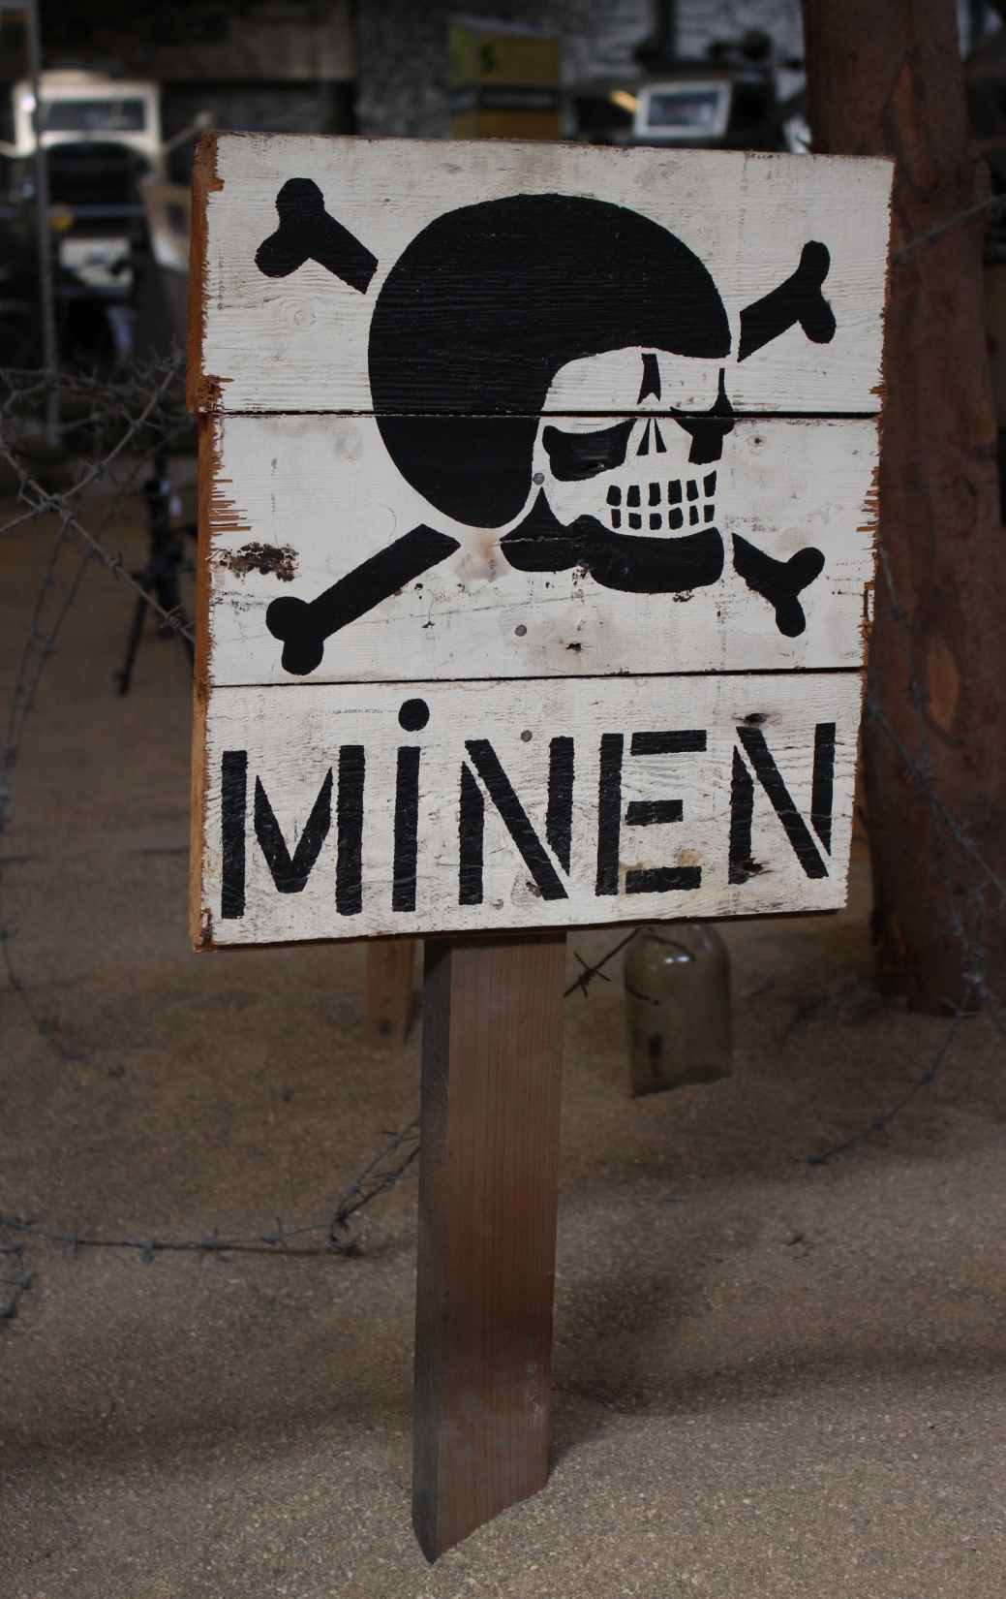

Slide 13
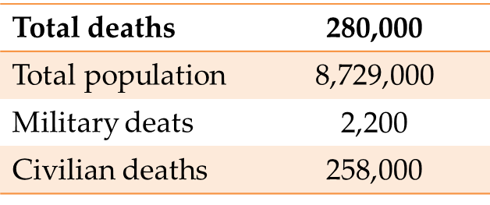
AFTER THE WAR
SLOVENIA >> YUGOSLAVIA
THE NETHERLANDS
Total deaths | 1,225,000
Total population | 15,400,000
Military deaths | 446,000
Civilian deaths | 581,000

Slide 14
AFTER THE WAR
Slavic peoples were treated like an under race compared to the Dutch people
The Germans considered the area where Slovenia is now as German territory, where only Germans should live
Deaths as % of 1939 population:
Yugoslavia – 7,96
The Netherlands - 2,36

Slide 15
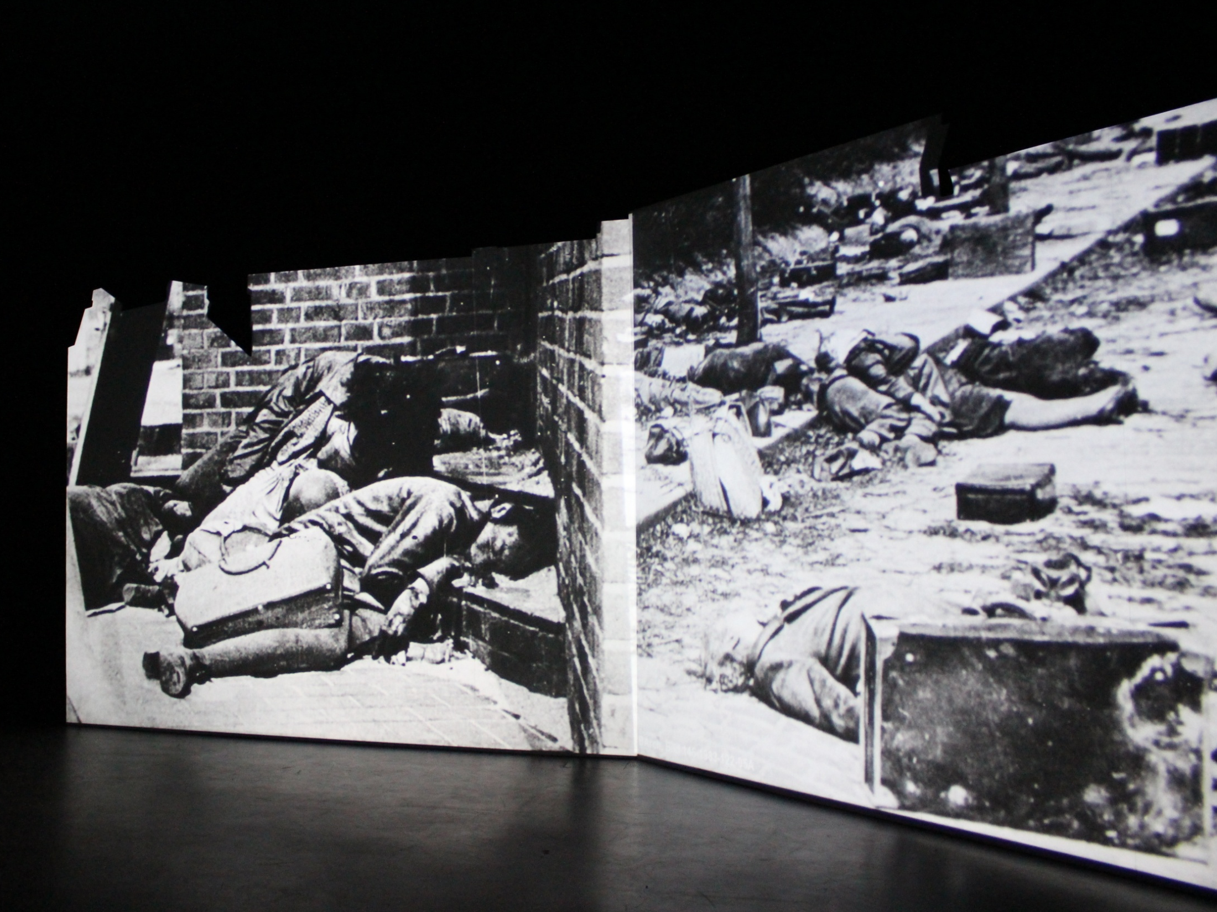

Slide 16
SOURCES
All the data were collected by interviews containsing personal stories and memories on tragedy during World war 2. We also found some information on internet sites:
http://ww2db.com/
http://en.wikipedia.org
http://www.tweedewereldoorlog.nl
http://www.historylearningsite.co.uk
http://www.miepgies.nl
http://www.scientificpsychic.com
and with student’s book Naše stoletje (Ana Nuša Kern, Dušan Nećak, Božo Repe; založba Modrijan). Visiting War museum in Overloon and Muzej novejše zgodovine Celje had big impact on our understanding of life during the war.
But the main focus of sources were before mentioned interviews.

Slide 17
As a young boy I realized that all people of good will want to be free, masters on their own land, and live happily in friendship and love. Those values are the most efficient weapons against the war which is the greatest enemy of ideas of mutual love, friendship, coexistence and respect.
Branko Mlačak

